Slide 1
CZ2101 Project 3
Group 3
“Knapsack Problem”
Lek Jie Kai
Lee Xuan Hua
Magdeline Ng Xuan Lynn

Slide 2
Question 1
Recursive definition of function P(C).

Slide 3
Recursive definition
 | 0 | 1 | 2
w[i] | 4 | 6 | 8
p[i] | 7 | 6 | 9
-C: Capacity of the knapsack (depends on w[i])
-P(C): Maximum profit that can be made by packing objects into the knapsack
of a certain capacity , C (depends on p[i])

Slide 4
Recursive Definition
 | 0 | 1 | 2
w[i] | 4 | 6 | 8
p[i] | 7 | 6 | 9
Set P(C) = 0, when P(C) = 0 or when P(C) < 4
Save the profit and return to previous state.
Repeat steps 1 and 2 by exploring with other weights values
Compare the profits and save the one with the highest profit
Repeat steps 1 to 4 till starting point is reached. Maximum profit possible is returned

Slide 5
Question 2
Subproblem graph for P(14)

Slide 6
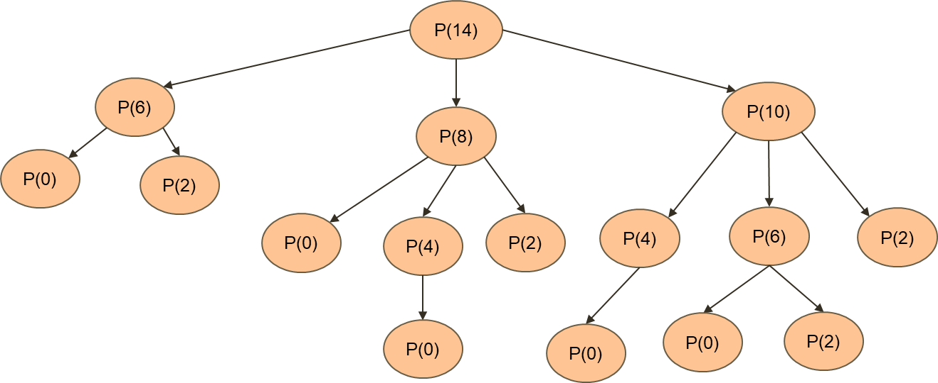
Weight | 4 | 6 | 8
Profit | 7 | 6 | 9

Slide 7
14
10
8
6
4
2
0

Slide 8
Question 3
Dynamic Programming Algorithm
(bottom-up)

Slide 9
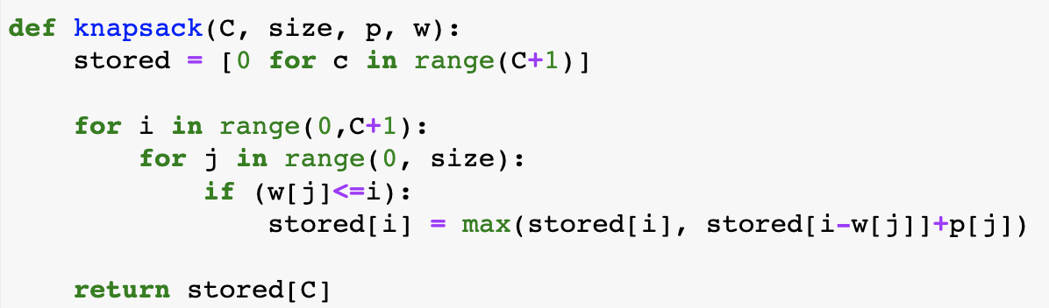
Dynamic Programming Algorithm
C - int: capacity p - list: profit
size - int: no. of objects w - list: weights
Initialise list with 0 for all values
Use recursive definition of P(C)
Goal: find stored[C] → maximum profit for capacity of C
Value in stored[i] = maximum profit that can be achieved with capacity of i

Slide 10
Question 4
Dynamic Programming Algorithm
Show program input and output for (a) and (b)

Slide 11
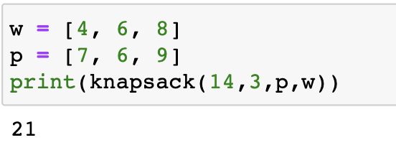
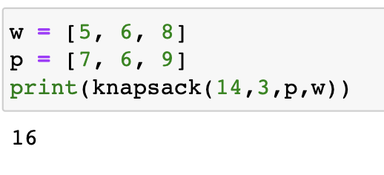
Program implementation
Case A
Case B
0 1 2
0 1 2
w
p
4 | 6 | 8
7 | 6 | 9
5 | 6 | 8
7 | 6 | 9
Profit: 21
Profit: 16

Slide 12
Thank you!

